Slide 1
Determinants For The Orientation Of Sexual And Reproductive Health Mesures In Haïti
Ayiti Analytics Capstone Project
30 sept 2021

Slide 2
Christelle’s Story
“I could have avoided this disaster if I had information.
I didn't know anything about sexuality, babies, life”

Slide 3

The situation in Haïti
1st in fertility rate
Last in GDP per capita

Slide 4

Hypothesis
There is a set of characteristics specific to Haïti that can be use
to identify women with a high level of fertility

Slide 5

Goals
Describe the demographic, socioeconomic and reproductive characteristics that influence the fertility of Haitian woman
Create a model that can predict the level of fertility of Haitian woman base on demographic socioeconomic and reproductive history

Slide 6

Methodology
Data Collection
Demographic and health survey program
Machine learning
Data Cleaning
Regression
Classification
Remove null observation and correcting data type
Exploratory data analyze
General understanding of how the variables affect the fertility.

Slide 7
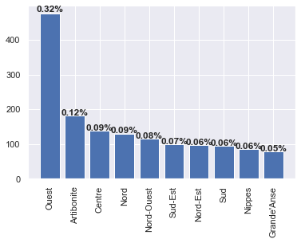
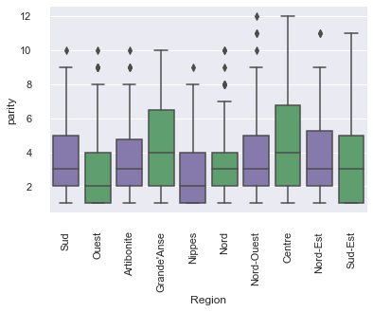
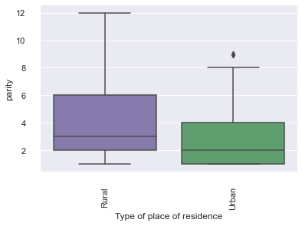
Results and Insights
The women from the Grande'Anse departement had the highest mean number of child born(4.5 children).
The women from the Grande'Anse departement had the youngest mean age at first sex(16.72 year).

Slide 8
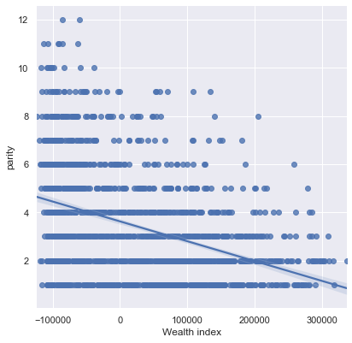
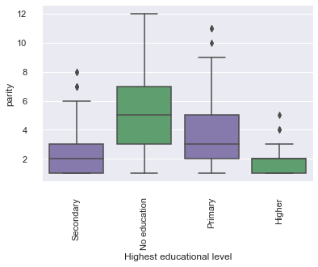
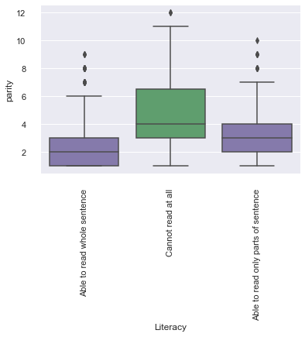
Results and Insights
The women who could not read at all were the ones with the highest mean number of born child(4.68 child).
The women with no education at all were the one with the highest mean number of child born(5.18).

Slide 9
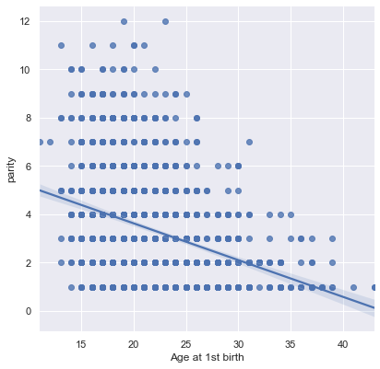
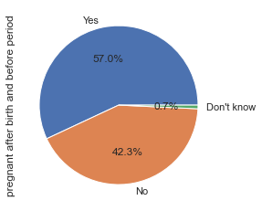
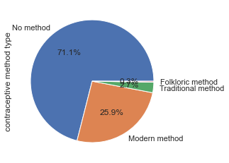
Results and Insights
50 % of the women had at least 3 children.
Half of our sample had a child by the age of 21.The number of child bared by a woman and the age at 1st birth are inversely correlated.
More than a half of the women knew that they could get pregnant after giving birth and before their periods.

Slide 10

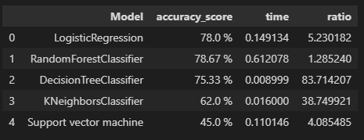
Machine learning

Slide 11
Conclusion
Main features
Department
Type of zone
Literacy
Education level
Wealth combined index
Knowledge of pregnancy
Age at first birth
Recommendation
Center the sexual and reproductive programs in the department of grande’ Anse and centre
Aim at women with no literacy , low to no level of education and a weak economic level
Create awareness-raising programmes on the dangers of early pregnancy and contraception
Provide medical support for women using contraceptive measures

Slide 12
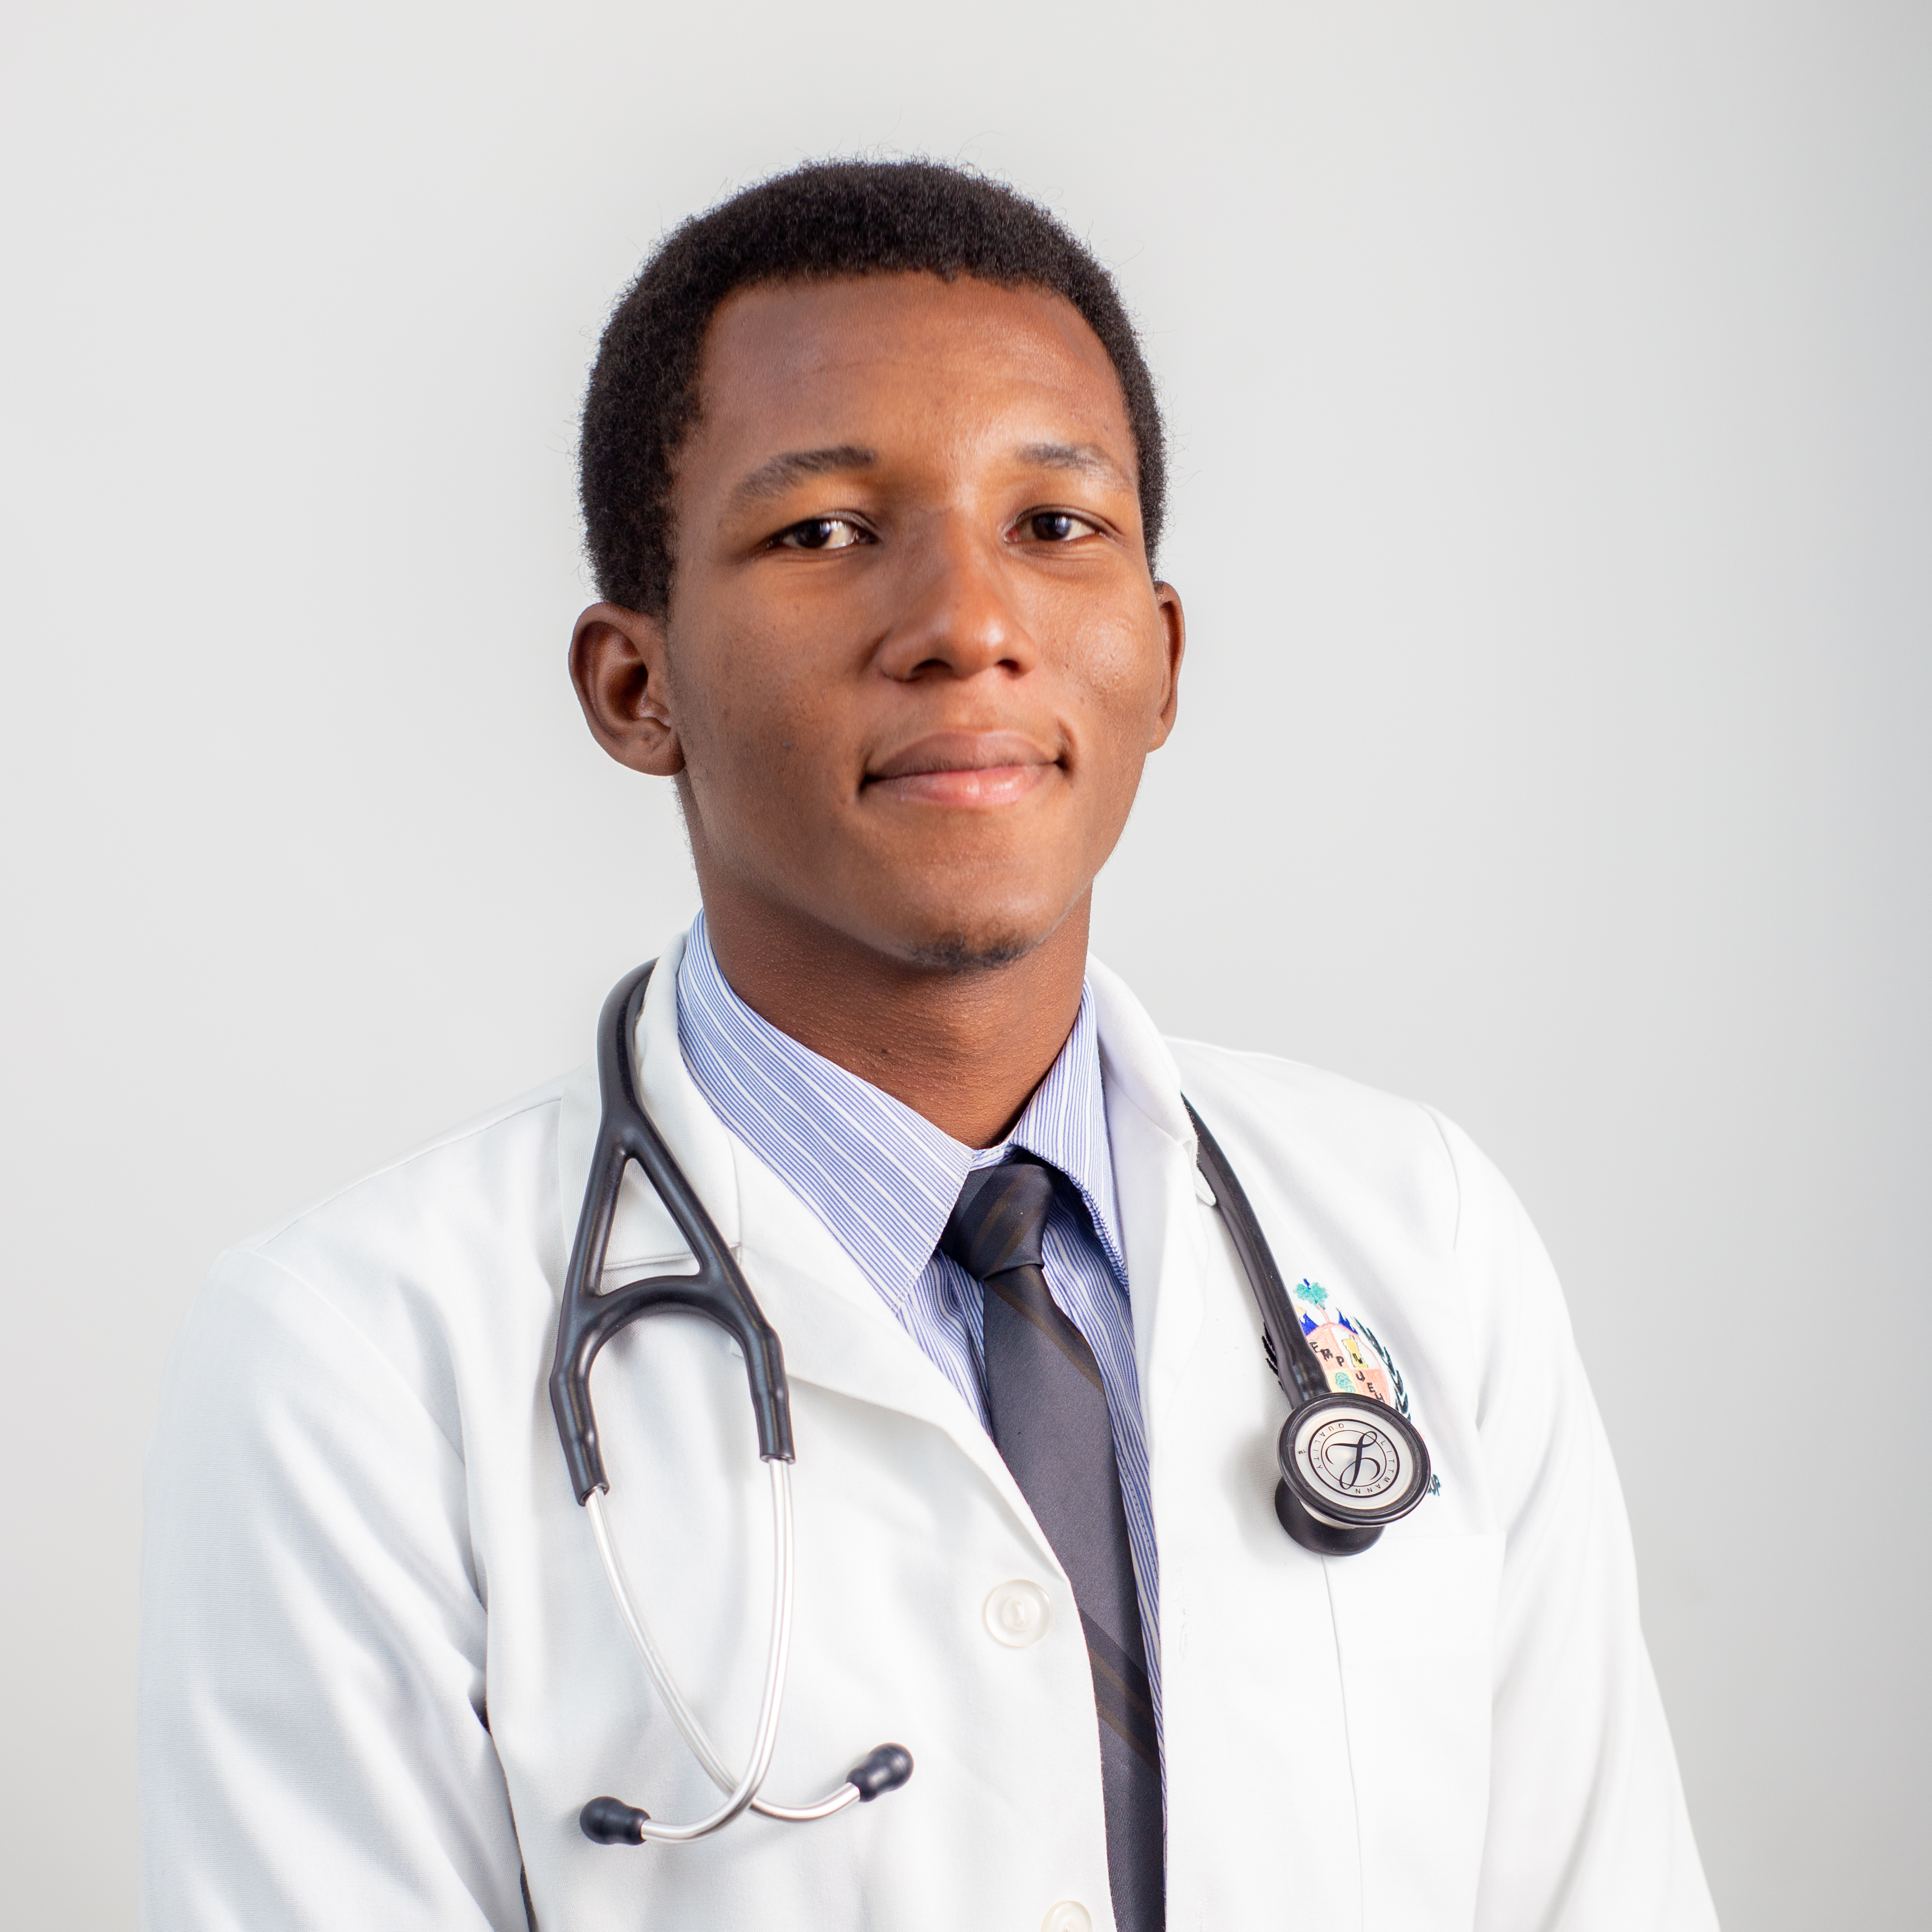
Thank you !
I am Camille Jackyvens
M.D
Leamic.cj@gmail.com
(509) 49 10 24 41

Slide 13
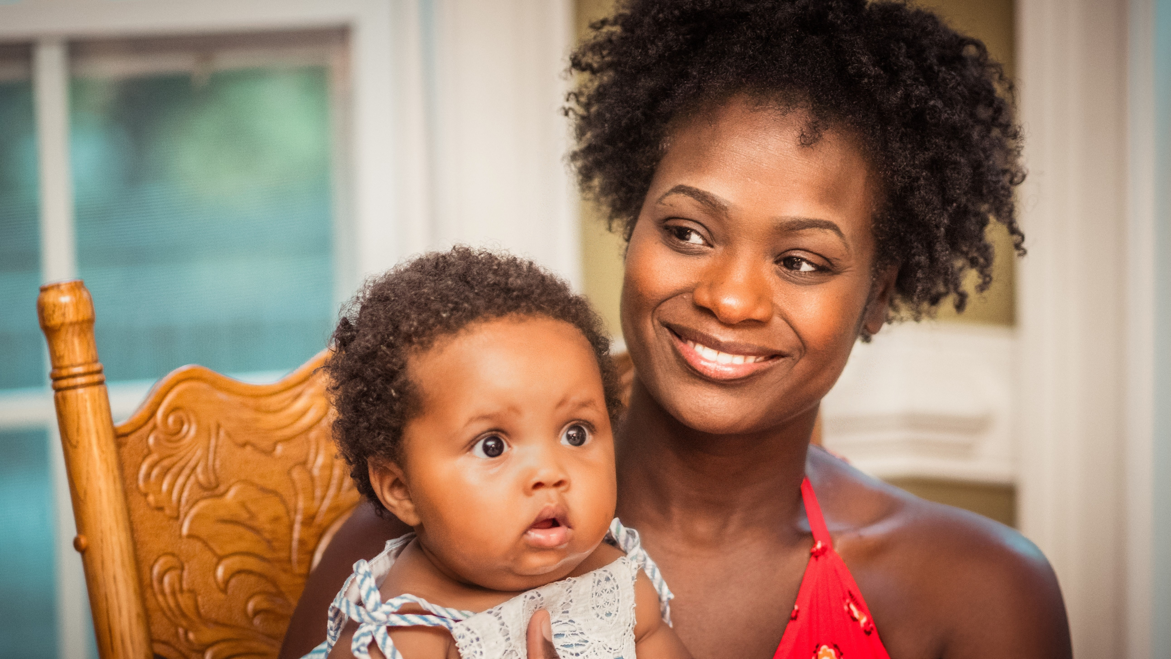

Slide 14

References & Contacts
Github link : https://github.com/leamic/AA_capstoneproject_camille_sept2021.git

